Slide 1
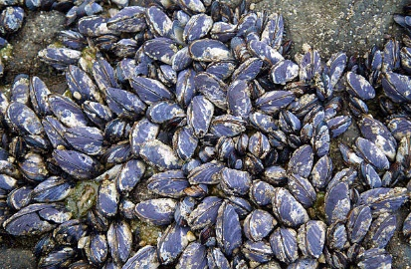
Pacific Blue Mussel
  (Mytilus trossulus)
  By: Brody Linton
  The pacific Blue Mussel is a invertebrate that is part of the Mollusca Phylum. The Pacific Blue is found in the Mid Intertidal zone. When it is low tide they avoid drying up by grouping together and sharing the moisture of their body’s to the rest of the group so they all stay moist. To feed, they open their shell slightly and let a lot of water in their shell and drain out all of the water until there are only phytoplankton left and they eat that. It is preyed by different types of sea stars, sea slugs, sea mammals, and sea birds such as gulls and terns, they are eaten mostly by sea stars. It avoids becoming food by trapping itself in its hard shell until the predator goes away or it fights back by suffocating some of it’s smaller predators like snails in its shell. When a mussel is defending itself by trapping itself in it’s shell it gets eaten anyways by seabirds dropping them on rocks, or sea stars pulling their shell apart with their tube feet they use to move. Only young mussels can move, the older ones will stay in place until they are eaten or are picked up by something. As they get older they anchor themselves to rocks so they can no longer move around. When mussels are zooplankton they settle onto rocks were other mussels were or are. They think it is safe to know that another mussel was there before it. Then they grow into mussels on that spot.
Fun Fact
An adult mussel can pump 25 gallons of water for food a day. They feed on the zooplankton in the sea water for food.
Notes:
Sources:
Atlas

Slide 2
References
Sigmen, R. C. (1999). Peterson Bay Field Atlas. CACS, 60.

